Slide 1
1015 Shanna’s Class
313/308/312/

Slide 2
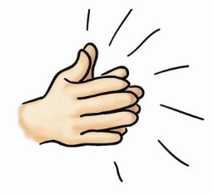
1.
Let’s read numbers 1-20 together!
a / e / i / o / u
and y
Clap hands!

Slide 3
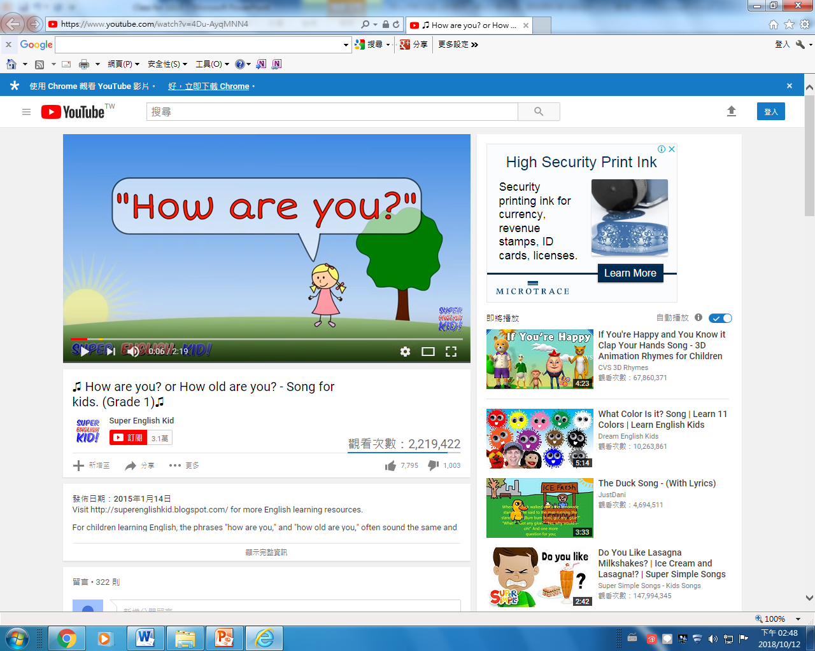
2. Song
Let’s listen to the song!
5 minutes
Fun time!

Slide 4
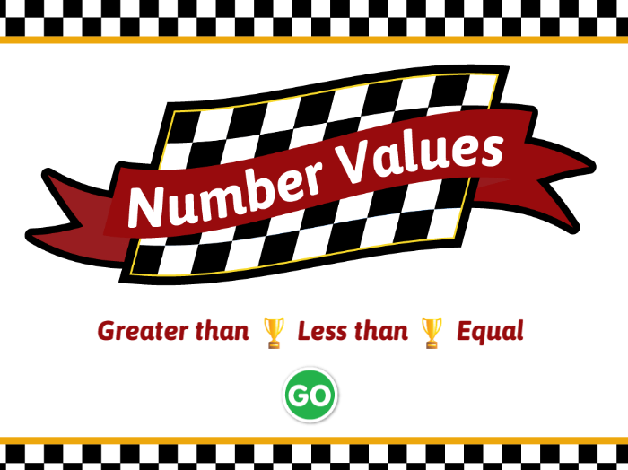
3.
Say the bigger number!
greater than >
less than <
equal =

Slide 5
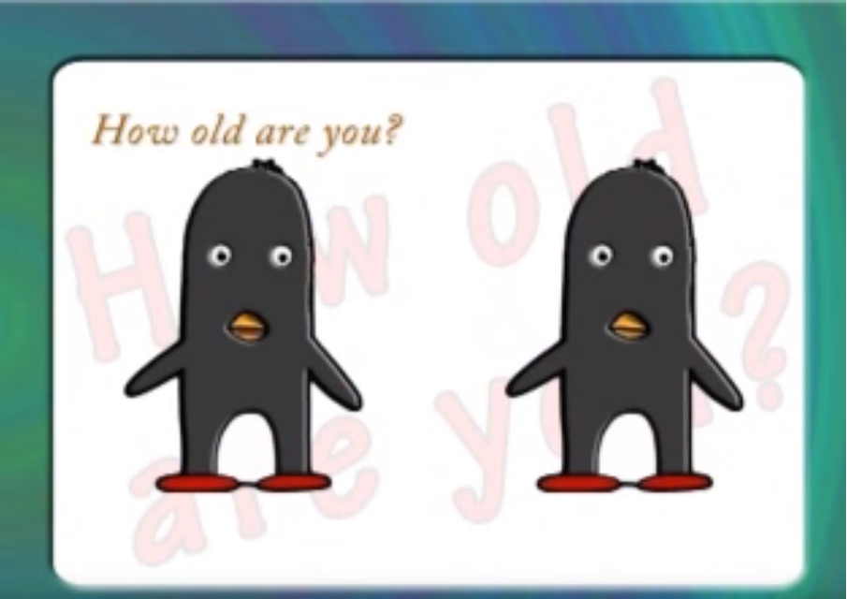
4. Song
older 較老
younger 較年輕

Slide 6
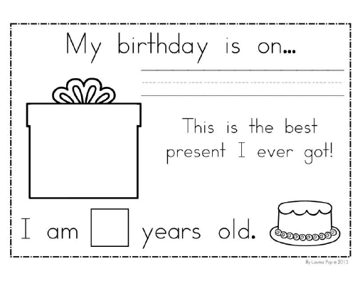
Ask Birthday or How old are you
Q1.
My birthday is on November 30th .
And you?
A1:
My birthday is on June 30th .
Q2.
How old are you?
A2:
I am nine years old.
12 months song

Slide 7
Homework
CD 1-32~1-34
SB P.24

